Slide 1
College of Education

Slide 2
College of Education
Academic / Division Departments
  Counselor Education
  Educational Leadership
  Library Science and Technology
  School of Teaching and Learning
Centers
  Steele Center for Professional Practice (Educator Preparation Services)
  Garrett Center for Transition Services
  Center for Assessment, Research, and Education Safety (CARES)
  Center for Research & Clinical Training in Trauma

Slide 3
FY 2024 Accomplishments
Priority 1: Prioritize Student Success and Student Access
  Launched Innovative Alternative Certification Program
  Received $5.2M DOE Mental Health grant
  Received $1.4M Noyce Grant for student success
  Strategic Staffing/Paid residency models across 22 districts
  133 students in paid residency positions
  UG degrees in Education Studies, Learning Technologies
  Continued as 4th largest EPP, highest teacher retention rates, and top number of Charles Butt Scholars

Slide 4
FY 2024 Accomplishments
Priority 2: Embody a Culture of Excellence
  Converted EdD in Literacy to a more comprehensive EdD in Curriculum & Instruction with multiple opportunities for high need specializations
  Approved as Vetted Teacher Residency program with TEA
  Expanded COE Research Center, with PD for 200+ attendees & 458 research consultation meetings with faculty, staff, & students
  Honored two new SHSU Distinguished Professors and two TSUS Regents Teaching Professors
  Received National Recognition with Distinction from the International Literacy Association, one of only four such programs nation-wide

Slide 5

FY 2024 Accomplishments
Priority 3: Elevate the Reputation and Visibility of SHSU
  Houston Endowment EPP continuous improvement model
  School Librarian of the Year Amanda Chacon
  Feature panelist for State Board of Education review on
  high quality residency opportunities and on EPP
  continuous improvement models for Texas
  SHSU Charter School –
    500 students, paid residencies, new superintendent
  CARES successes -
    $1.5M with Texas School Safety Center for priority development
    Final stages of DSHS grant for $6.5M, across 4 colleges
    Commercialization of crisis response leadership training

Slide 6

FY 2024 Accomplishments
Priority 4: Expand and Elevate our Service to the State and Beyond
  Launched high quality Alternative Education Certification (ACP) to help meet extensive state-wide teacher shortage
  Received $5.2M grant focused on preparation of mental health professionals in school settings
  Piloted statewide Effective Educator Preparation framework model and served as invited panel to State Board with feedback
  Developed statewide model for teacher
    performance-based assessment
  Jack Staggs Counseling Clinics provided 3055
  hours of services to 326 unduplicated clients
  Rose Brock named National Book Award Judge

Slide 7
FY 2025 Keep Doing
Statement: The College of Education plans to continue seeking external funding and grant opportunities to support students and programs, as this action increases overall capacity and has a direct positive impact on students and partners. This action aligns with prioritizing student success, student access and recruiting, retaining, graduating, and empowering students to drive sustainable growth; and will have measurable impact in comparing trends of external funding to enrollment and retention rates in achieving enrollment.
Supporting Data: 6 current awards over $1M; $17.5M in pending grant applications; active applications for ISD Grow Your Own programs; 90 students awarded a total of $662,551 of scholarships in FY24 from active grants.
Resources / Collaborations Required: No additional funding required

Slide 8
Supportive Data

Slide 9
FY 2025 Keep Doing
Statement: The College of Education plans to keep developing rich and streamlined pathways to certification/degrees with district partners and community partners to facilitate community engagement because this action increases recruitment opportunities. This action aligns with prioritizing student success and student access and recruiting, retaining, graduating, and empowering students to drive sustainable growth; and will have measurable impact of increased opportunity and data based on pathways and partnerships in achieving enrollment.
Supporting Data: 735 degrees awarded in 2022-2023; 306 Bachelors; 393 Masters; 37 Doctoral; strategic staffing models across 22 districts; 133 students in paid residencies
Resources / Collaborations Required: No additional funding required/ current faculty and staff/administrators will work to secure these partnerships; continued communication and collaboration with district partners.

Slide 10
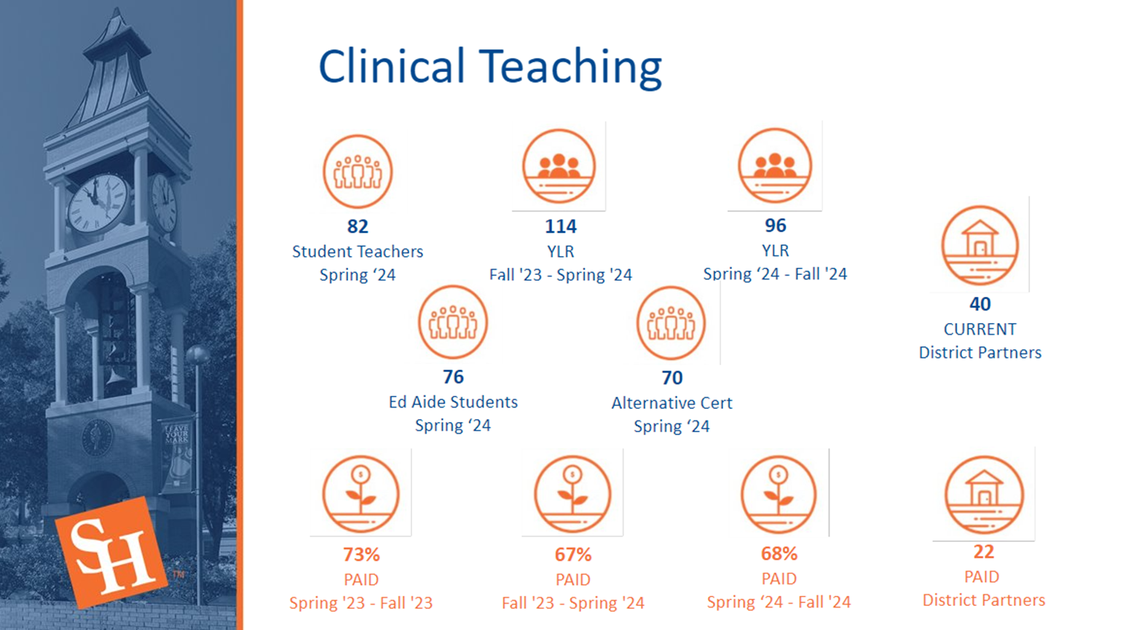
Supportive Data

Slide 11
FY 2025 Stop Doing
Statement: The College of Education plans to stop fully incremental budgeting because this practice has not kept pace with current and changing needs. This shift in the budget model will ensure that more strategic priorities are funded within areas by implementing a modified zero-based budget. This action aligns with embodying a culture of excellence and aligning processes and resources, such as staffing, facilities, technology, and other assets to strategic priorities; and will have a measurable impact as we will be able to measure budget to priorities and ensure efficiency through both planning and spending in achieving agility.
Supporting Data: Flat to reduced funding (factoring inflation) and shifting priorities due to enrollment needs, grant administration, have necessitated a new budgeting model
Resources / Collaborations Recovered: Identified recovered resources will be repurposed during strategic alignment of FY25 budget

Slide 12
Supportive Data

Slide 13
FY 2025 Stop Doing
Statement: The College of Education plans to stop unnecessary barriers to graduate admissions, including application requirements and time to decision because there has been an identified need to ensure that students who apply are proceed through in a timely manner to ensure higher probability of enrollment. This action aligns with prioritizing student success and student access and recruiting, retaining, graduating, and empowering students to drive sustainable growth; and will have measurable impact in comparing trends of external funding data to enrollment and retention rates in achieving enrollment.
Supporting Data: Decreased enrollment in graduate programs critical to student success (see next slide).
Resources / Collaborations Recovered: This action will likely require additional collaboration with department Chairs and program advisors. Immediate recovery of resources is not expected as these activities have little to no financial obligation.

Slide 14
Supportive Data

Slide 15
FY 2025 Stop Doing
Statement: The College of Education plans to stop any unnecessary barriers in working with grant-related units across campus because such actions have potential negative consequences for current and future external funding opportunities. This action aligns with embodying a culture of excellence; achieving revenue generation and optimization; and will have a measurable impact on revised practices that may have an impact on external funding generated in achieving agility.
Supporting Data: With ≈$20M in active grants and $17.5M in pending grants, grant activity within the COE has increased substantially over the past few years. This increase in grant activity has made the ease of submitting these grants without barriers critical to continued funding and applications.
Resources / Collaborations Recovered: No new resources are required. We hired a Grant Coordinator in FY24 from existing IDC funds to help with grant operations and campus collaboration.

Slide 16
Supportive Data

Slide 17
FY 2025 Start Doing
Statement: The College of Education plans to start implementing market-sensitive tuition models for targeted graduate programs in order to remain competitive in the external market and ensure certain graduate programs are admitting qualified applicants and remaining sustainable. This action aligns with prioritizing student success and student access and recruiting, retaining, graduating, and empowering students to drive sustainable growth; and will have a measurable impact by having more market-sensitive models in achieving enrollment.
Supporting Data: The COE has several online graduate programs that are priced higher than competitors, including the School Leadership program.
Resources / Collaborations Required: Any decreases in tuition will be offset by increased enrollment; continued collaboration with SHSU administration will be essential to this effort.

Slide 18
Supportive Data

Slide 19
College of Education
KEEP DOING
  External funding and grant opportunities to support students and programs
  Developing rich and streamlined pathways to certification/degrees with district partners and community partners to facilitate community engagement
STOP DOING
  Fully incremental budgeting
  Unnecessary barriers to graduate admissions, including application requirements and time to decision
  Any unnecessary barriers in working with grant-related units across campus
START DOING
  Seek market-sensitive tuition models for certain graduate programs

Slide 20
Questions?

